Slide 1
Helping Students Practice Diversity in Advertising Development
FOTL January 14, 2021 Pam Morris, PhD
Associate Professor, Program Director Ad/PR
School of Communication

Slide 2
Background
Diversity
- Enhances creativity, leads to innovation, better decision-making, more effective problem solving (Appiah & Saewitz, 2016; Phillips, 2014)
Advertising
- 5% African Americans (Appiah & Saewitz, 2016; Schultz, 2011)
- 3% women creative directors (Diaz & Zmuda, 2014)

Slide 3
How can we include multiple voices and be more inclusive when building advertising campaigns?

Slide 4
COMM 211 Principles of Advertising

Slide 5
Activities/Assignments
Meaning of diversity – think/write notes on cards/discuss with groups
Diversity exercise - questionnaire

Slide 6
Questionnaire
I am confident in working with teams of different… skill sets… genders…ethnicities
I am confident in working with diverse audiences when developing… target audiences…creative briefs… scripts/ storyboards
Studying diversity/inclusion has made me aware of these issues in the ad/PR profession
I will draw on ideas I learned about diversity/inclusion to talk about these issues with peers

Slide 7
Activities/Assignments
Research diversity statements on ad agency, other organization websites
Create diversity/inclusion statement for agency team/incorporate throughout campaign development: target audience, creative brief, creative tactics

Slide 8
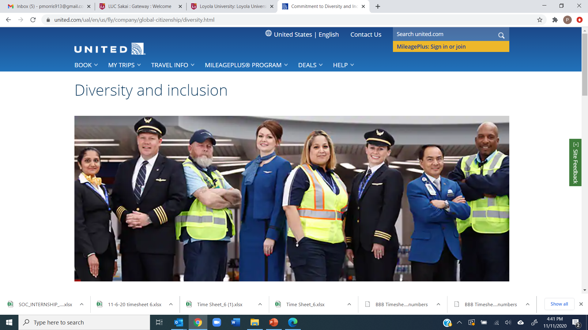
Corporate Diversity Statements

Slide 9
United airlines
Our shared purpose, “Connecting People, Uniting the World” is about more than being a conduit between global cultures, it is about demonstrating that investing in inclusivity is what is good for our business, our employees, and our customers. We have a tremendous opportunity to build upon our commitment to diversity and inclusion, ensuring our people and processes are as diverse and as far-reaching as the communities we connect and the customers we serve. Our shared purpose drives us to be the best airline for everyone in the United family and beyond. Scott Kirby, CEO

Slide 10
Students’ Statements
Happy Agency’s mission is to create a friendly environment that brings communities together. Everyone, no matter their identity, is welcomed in this association. We are committed to a diverse workplace to better understand the needs of our clients. We stay true to who we are – just happy individuals.

Slide 11
Students’ Statements
It takes a village to raise a baby and it takes a village to run a company. Here at KIC Start, we advocate that our village be as inclusive and welcoming as possible from the beginning of the creative process to the end product. We are passionate about curating an environment where employees feel welcomed to be their authentic selves.

Slide 12
Students’ Statements
Diversity is a foundational value here at Lucky Advertising. We are lucky to have a variety of views as it is crucial to our success with effective communication. Since inclusion is a key principle within our company, we pride ourselves on being supportive and welcoming towards all ethnicities, genders, sexual orientation, disabilities, and other personal backgrounds. We strive to uphold the highest standard of fair policies, equal opportunities and spreading positive messages.

Slide 13
Learning
Students think it’s an important topic for discussion (94% strongly agree/agree)
Students fine with talking about diversity, 97% confident, but less confident (93%) when asked to incorporate into process
Students need guidance in application – incorporating diversity into the process of advertising development – research, strategy, media, creative, tactics
Activities helped them 92%

Slide 14
Learning
Want a more inclusive definition of diversity, beyond gender and race, to include age, ableness, religion, and sexual-orientation

Slide 15
Learning
Students want more discussion, SOC provided substantial emphasis, 57%
Studying made them aware of issues in ad/PR, 83%, and 79% talked to friends/family about issues learned in class
Exercise and practice, helps, including across courses, can encourage multiple student voices and can continue on into industry

Slide 16
Sources
Appiah, O., & Saewitz, D. (2016). Advertising industry diversity: We’ve “kind of” come a long way baby, but larger pipeline and more intentional action from industry and educators needed. Journal of Advertising Education, 20(1/2), 92-96.
Diaz, A. C., & Zmuda, N. (2014). Less talk, more women at the top. Advertising Age, 85(18). DOI: 00018899
Fullerton, J. A., Kendrick, A., & McKinnon, L. M. (2013). Advertising ethics: Student attitudes and behavioral intent. Journalism & Mass Communication Educator, 68(1), 33-49.
Gale, K., & Bunton, K. (2005). Assessing the impact of ethics instruction on advertising and public relations graduates. Journalism & Mass Communication Educator, 60, 272-285.
Newell, J., Tavanapong, W., & Berghefer, S. (2017). Teaching ad tech: Assessing collaborative teaching in an advertising, computer science and design course. Journal of Advertising Education, 21(2), 45-53.
Phillips, K. W. (2014, October). Being around people who are different from us makes us more creative, more diligent, and harder-working/How diversity works. Scientific American, 311(4), 43-47.

Slide 17
Thank you
Pam Morris
pmorris1@luc.edu

